Slide 1

Sponsor, Mentor, Coach Program

Slide 2

Why Should You Become A Coach/Mentor/Sponsor?
  Develop team-building skills.
  Expand leadership experience.
  Increase proficiency as a facilitator and negotiator.
  Develop diplomacy skills.
  Share expertise.
  Earn credit toward the Distinguished Toastmaster award.

Slide 3
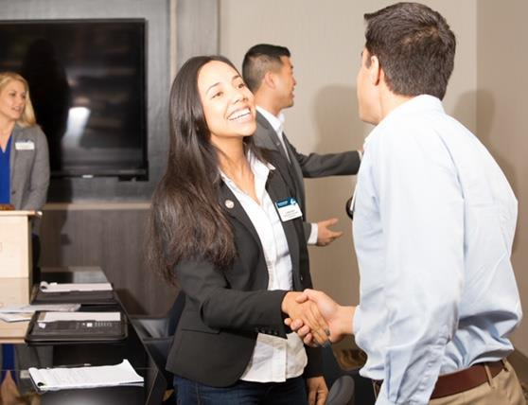
Who is a Club Coach?
An effective Club Coach:
  Builds rapport.
  Observes and analyzes the club environment.
  Helps the club develop goals.
  Enables the club to achieve goals.
  Instills enthusiasm, fidelity, and a sense of responsibility.

Slide 4
When are clubs eligible to get a Coach?
  Have at least three but no more than 12 members in good standing at the time of the appointment.
  Not be suspended or closed.
  Have atleast one club officer who has completed the Club Coach Program
  Not have more than two coaches appointed at one time.
  Training Module.
➢

Slide 5
Eligibility Criteria to be A Club Coach
  Be a paid member in good standing.
  Have been a member of Toastmasters International for a minimum of one year.
  Have previously served as a club officer for one full annual term or two full semi-annual terms.
  Have completed the Club Coach Training module in Pathways.
  Have completed a minimum of Level 2 in any path.
  Must not have been a member of the club you intent to coach within the previous six months.

Slide 6
How to earn the credit?
To earn Club Coach Credit –
To earn District Officer Credit –
➢ ➢
Serve as a Club Coach for at least six months. Have the assigned club earn an award within
the Distinguished Club Program during the
two-program-year appointment.
Complete the required progress reports in the
timelines established by the Club Coach
Program.
Have the Club President of the coached club
notify World Headquarters in writing that the
coaches have completed the requirements of
their role.
➢
In addition to the criteria mentioned to attain the Club coach credit, one must also ensure —
The appointed club must have at least 20 paid members on the roster as of the June 30.
➢
➢
➢
Note: A Club Coach has to serve minimum six-months to receive club coach completion credit.
Hence a coach should be appointed by December 31, 2026 in order to meet the requirement this program year.

Slide 7
Who is a Club Mentor?
  A mentor is someone who shares their expertise and knowledge with one or more people who have less experience.
  A Club Mentor guides its growth after chartering.

Slide 8
Role of a Club Mentor
Guidance: Provides advice and support to the club's members after it is chartered.
Training: Helps members develop their communication and leadership skills as well as ensure they understand the intricacies of the Toastmasters program.
Long-term Support: Works with the club for a minimum of six months after the charter date.
Club Success: Mentors play a crucial role in the new club's success and development.
Credit: Mentors can also receive credit towards their DTM award.
Optional Membership: Not required to join the club.

Slide 9
Who is a Club Sponsor?
  A Sponsor is a person who helps to establish a new club.
  Helps with any and every pre-charter support required.

Slide 10
Role of a Club Sponsor
Recruitment: Sells the idea of a Toastmasters club to potential members.
Organization: Assists with setting up the first meetings and ensuring the club adheres to Toastmasters structure.
Paperwork: Helps with the charter application and other necessary documentation.
Charter Presentation: May help plan the club's charter presentation ceremony.
Time Commitment: Typically involved for a few months, ending when the club is officially chartered.
Credit: Sponsors can receive credit towards their Distinguished Toastmaster (DTM) award and must apply within 90 days of the club’s charter date.
Optional Membership: Not required to join the club.

Slide 11
Making the Club Connection
➢ ➢
Observe club dynamics.
➢
Foster a sense of ownership.
Emphasize teamwork.
Let them know that you are there to help them.
Encourage clubs to use
other clubs as models.
Support the addition of
their own unique style.
Develop personal rapport
➢
with members.
Gain their trust and respect.
Use the Club Coach
Troubleshooting Guide.
Assist the members in
fulfilling their individual
goals.
➢
➢
➢
➢
➢
➢

Slide 12

Questions?

Slide 13

Thank You!
For any query feel free to reach out to:
CGD - Asankhya Vishwa Mohan

