Slide 1


MEMBERSHIP BUILDING CAMPAIGNS
Conversion Creates Growth, Retention Builds Lasting Success.

Slide 2
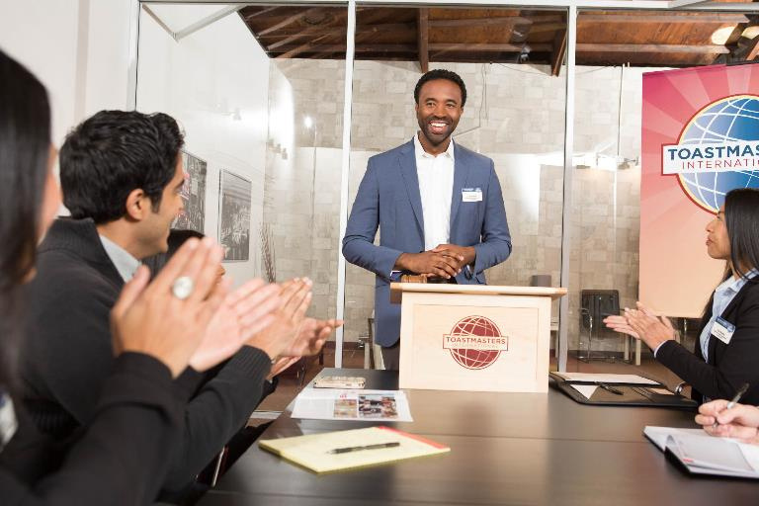

Guest Interaction
  Turn every guest visit into an experience they'll want to come back for.
  When guests experience real value, becoming a membership is the natural next step.
CGD TEAM (2026-27)

Slide 3

Best Practices When Hosting Guests (Online/Offline)
  Warmly Welcome Every Guest
  Facilitate a Thoughtful Introduction
  Encourage Participation
  Recognize Guest Participation
  Seek Constructive Feedback
  Encourage Meaningful Interactions
  Capture Guest Information
  Include Guests in the Group Photo
CGD TEAM (2026-27)

Slide 4

The Perfect Pitch
  Know Your Guest
  Personalize the Conversation
  Share Your Journey
  Listen & Respond with empathy and clarity.
  Highlight Mutual Value
CGD TEAM (2026-27)

Slide 5

Nurture the Relationship
  Express Gratitude – Send a personalized thank-you note.
  Invite Early – Share the next meeting invitation well in advance
  Stay Top of Mind – Send a timely reminder before the meeting.
CGD TEAM (2026-27)

Slide 6
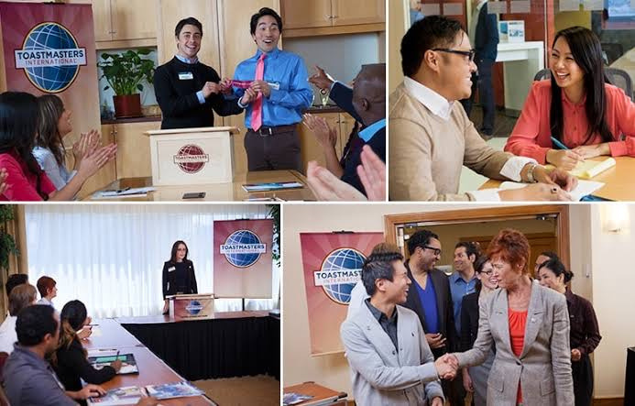
Strategies to Retain Members
  Participation in meetings
  Track of Attendance
  Acknowledgement of their achievements
  Informal Gathering with the members
  Adding Values by Proper Evaluation & Mentoring
  Special Initiatives
CGD TEAM (2026-27)

Slide 7
Ultimate Truth
Not every guest will become a member, and not every member will stay, but every interaction is an opportunity to create a lasting impact.
CGD TEAM (2026-27)

Slide 8
THANK YOU!
Asankhya Vishwa Mohan
+91-87072 88742 mohanasankhya@gmail.com

