Slide 1

Understanding Charter Documents
ATO-1-app-to-organize-ff.pdf
ATO-club-chartering-requirements-ff.pdf
433-charter-membership-and-club-officer-information_2.xlsx
Prepare Invoice
Charter your new club - Activity

Slide 2



Information Gathering Checklist
1. Corporate & Location Profile
2. Financial & Leadership Nominees
Ensure administrative host profile matches exact corporate records:
Pre-approvals required for payments and officer boards:
•
Get Approval for the Payment of Chartering a club. What will be Payment method. Any Tax Exemption
•
Official Toastmasters Club Name.
•
Complete Physical Address (including room, block, and coordinates).
•
Roster of minimum 20 prospective members.
•
Identify 7 Excom roles
•
When and at what time they will have the meetings. Online / Offline / Hybrid.
•
Identify and onboard Club Coordinator/President/HR details.
3. Pre-work of ADs
•
Get 2 Mentors and 2 Sponsors for the new club. Who should be?
•
Sponsoring Clubs. Why this is required?
•
District Alignment: Enter your assigned District, Division, and Area.
•
Prepare Invoice

Slide 3
Part 1: Application to Organize
Step-by-step verification of blank fields inside the initial form: "ATO-1-app-to-organize-ff.pdf".

Slide 4
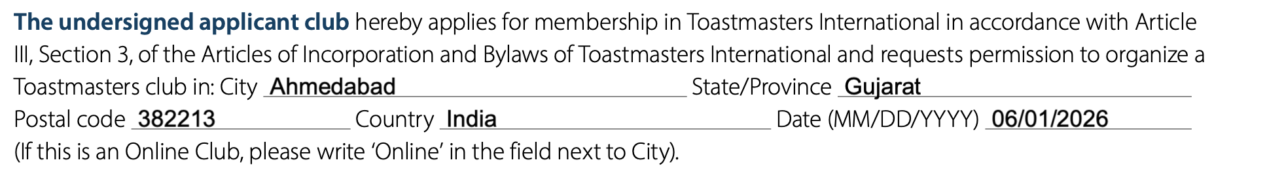
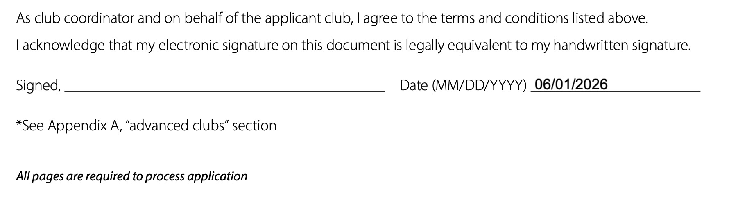
Form 1: "Application to Organize a Toastmasters Club"

Slide 5
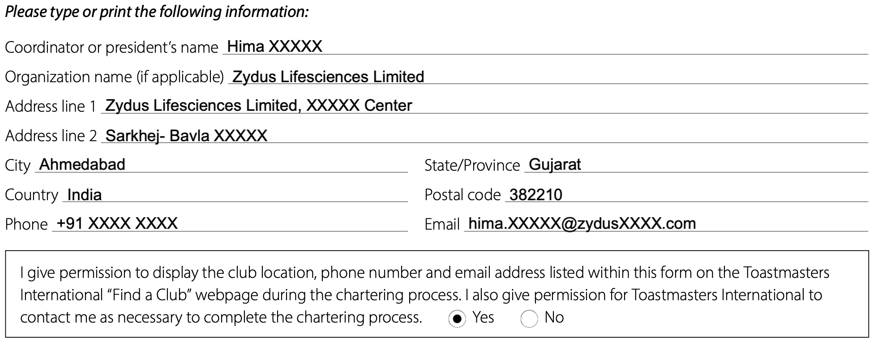
Form 1: "Application to Organize a Toastmasters Club"
Note: You need to check mark YES if you want the club to be visible in “Find a Club” Even for corporate it is advisable to make them aware, that their address and the VP membership / President Ph. Number will be shown in the TI website.

Slide 6
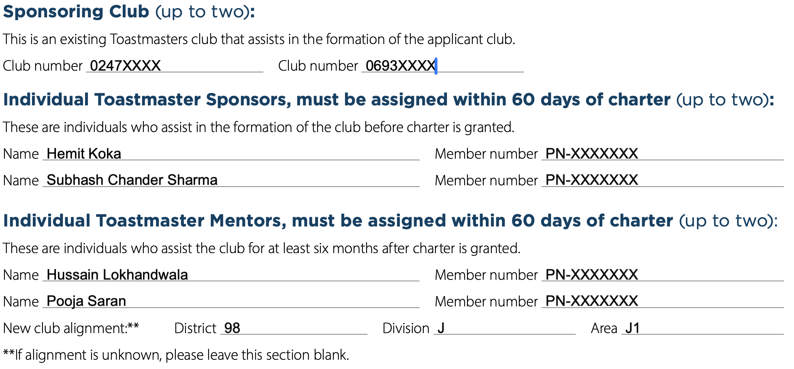
Form 1: "Application to Organize a Toastmasters Club"

Slide 7
Part 2: Charter Requirements
Analyzing key structural fields and financial tables within the master document: "ATO-club-chartering-requirements-ff.pdf".

Slide 8
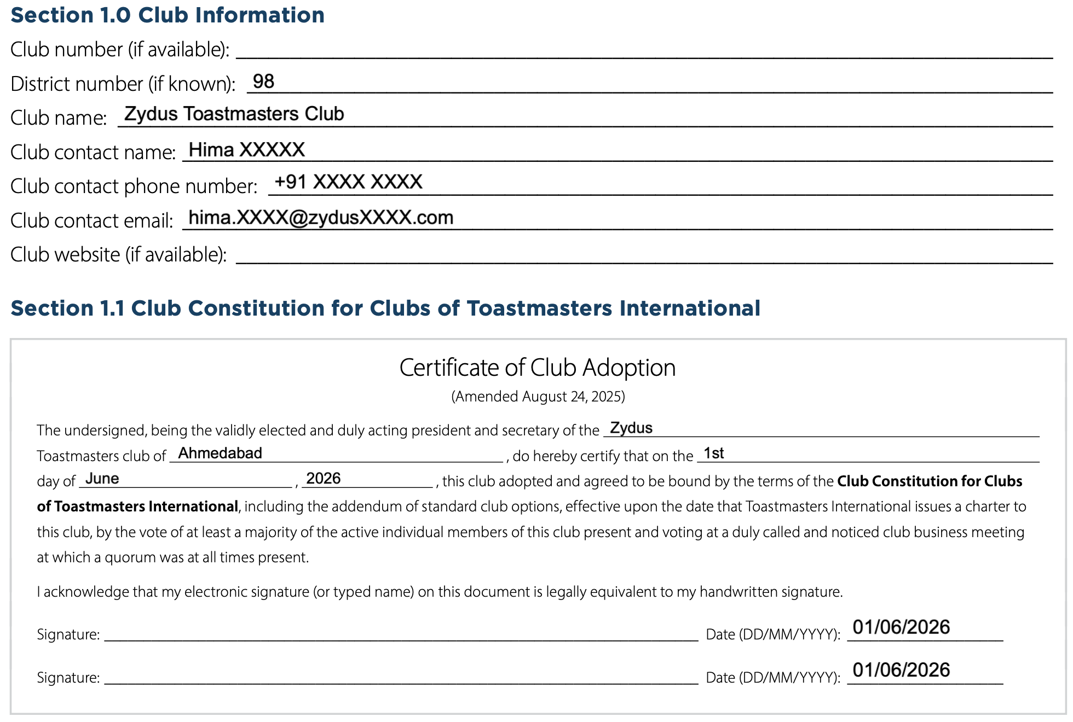
Form 2: “Club Charter Requirements Form”

Slide 9
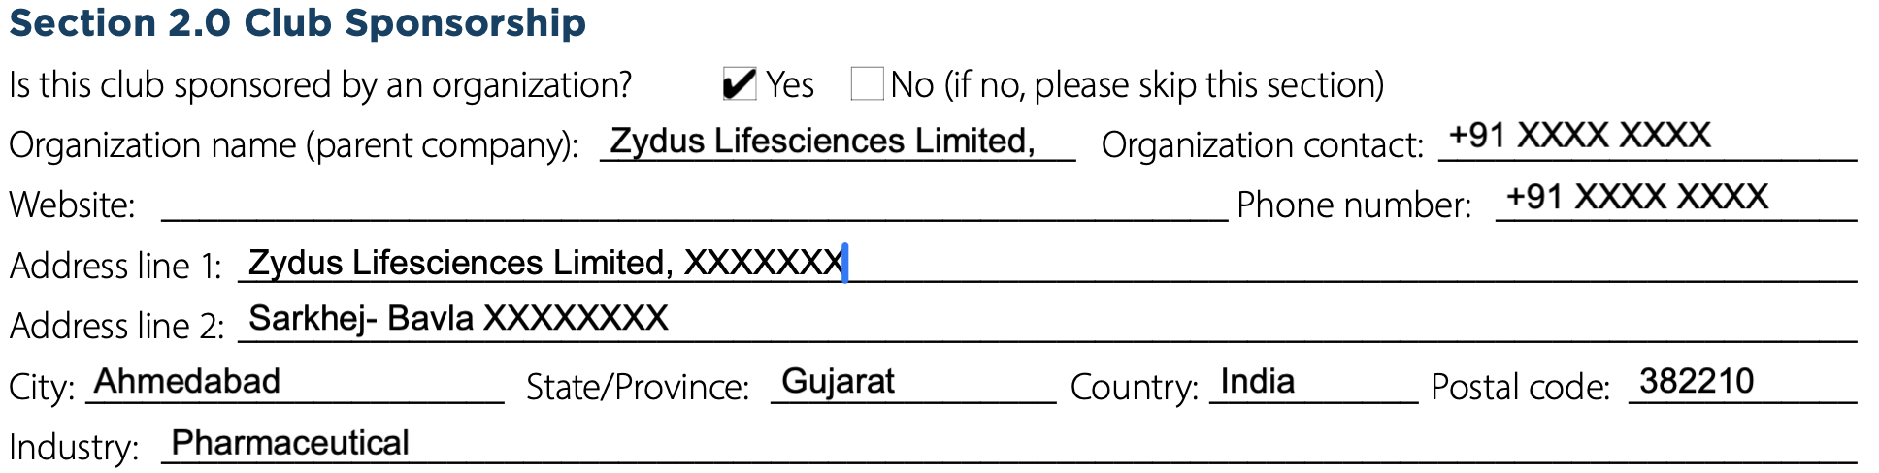
Form 2: “Club Charter Requirements Form”
If the fees are paid by the company then we need to fill this. If it is not sponsored then leave it blank.

Slide 10

Form 2: “Club Charter Requirements Form”
IMPORTANT:
This is where you might face some issues if it is a corporate club and they want to opt for Tax-exempt “Reverse Charge Mechanism” - i.e. Company will not pay the GST to Toastmasters but they will directly pay to Indian Government.
In this case you need to get a GST Certificate provided by Organization and get it approved on email at taxquestions@toastmasters.org.
Accordingly you need to provide Performa Invoice. Will cover in Invoice section.

Slide 11
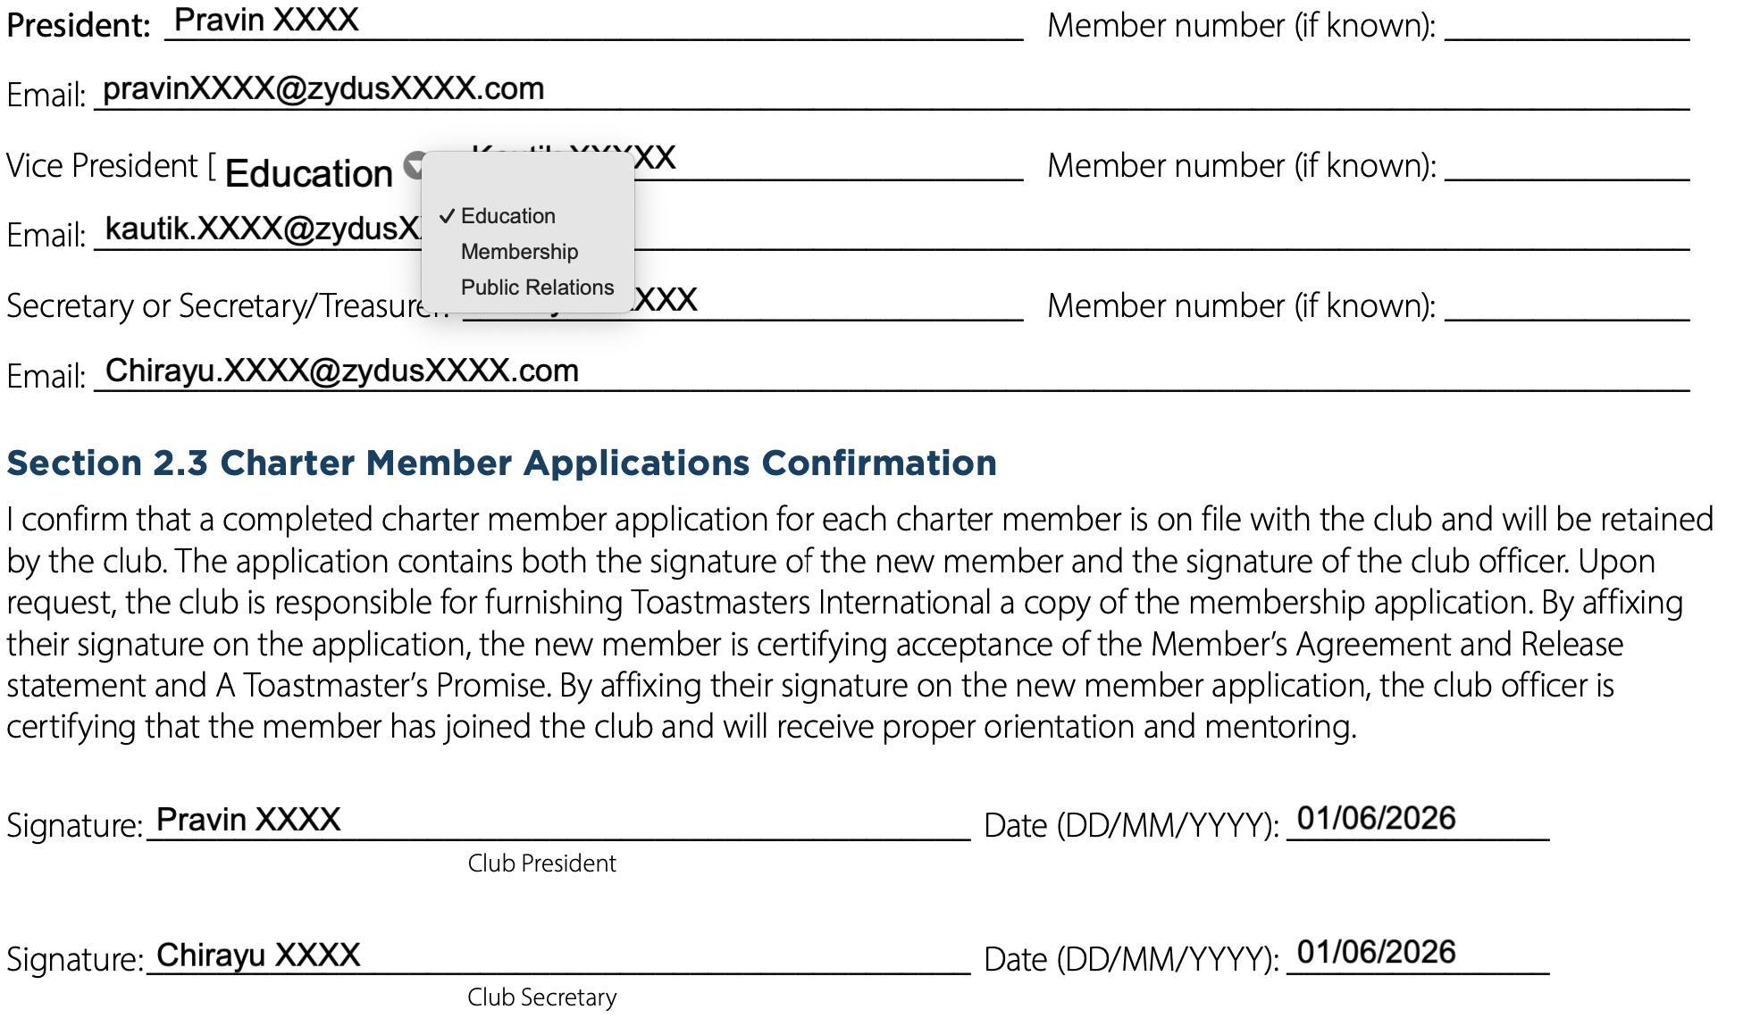
Form 2: “Club Charter Requirements Form”

Slide 12
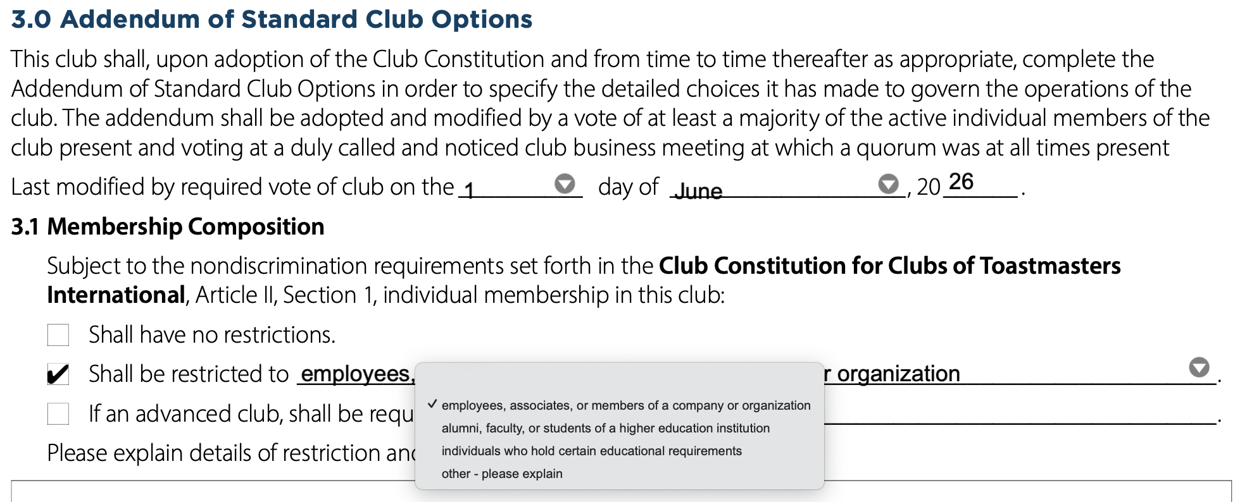
Form 2: “Club Charter Requirements Form”

Slide 13
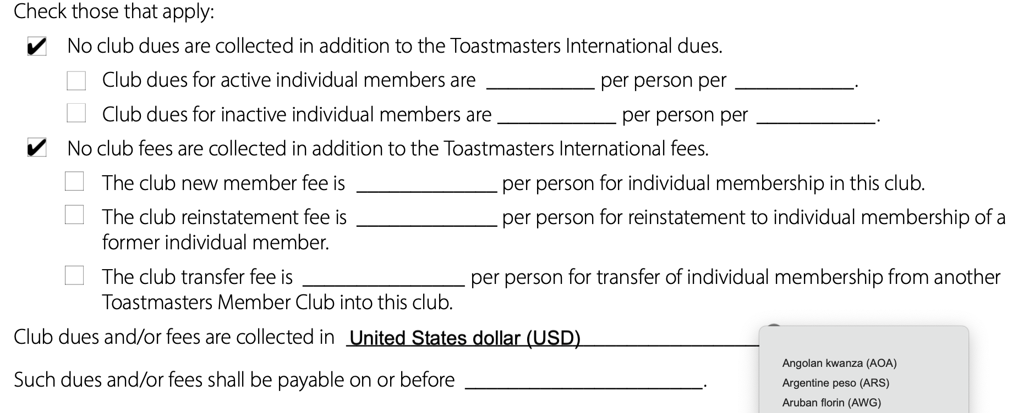
Form 2: “Club Charter Requirements Form”
Transfer member: No fees to be added.
Dual membership / Reinstated membership : Only the club dues to be added: 60$

Slide 14
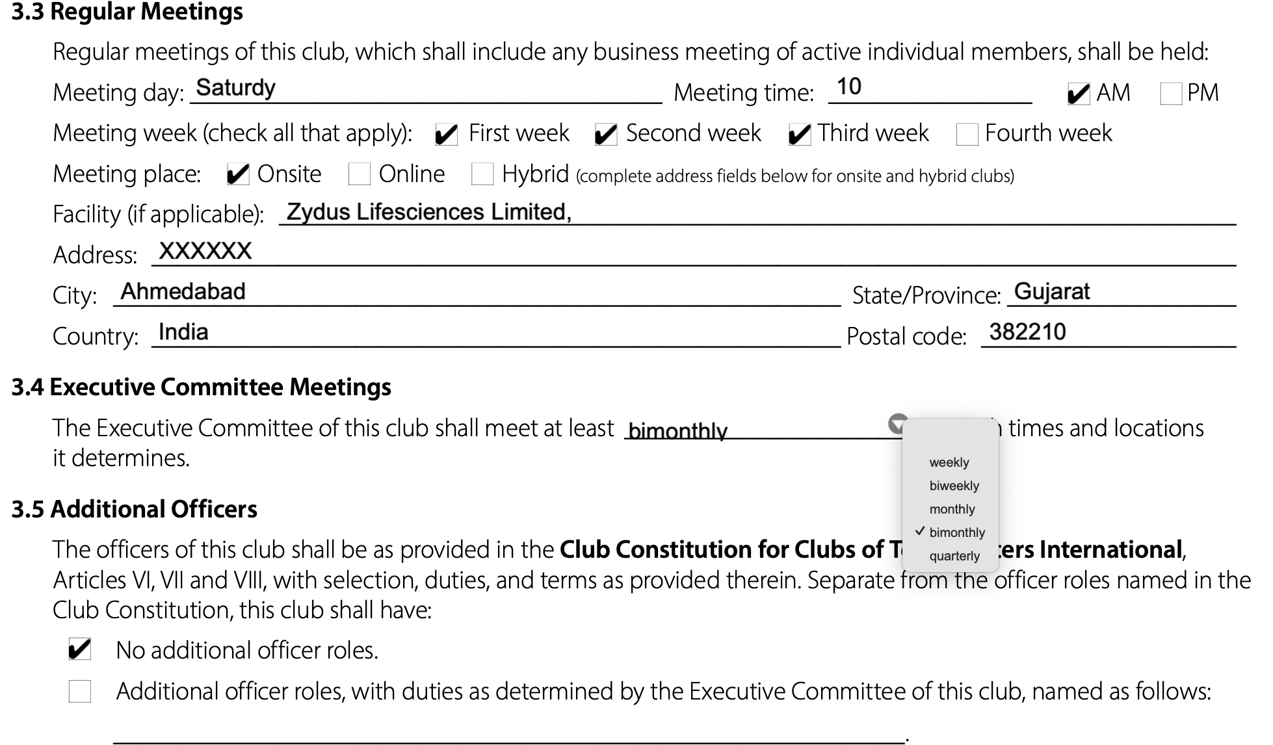
Form 2: “Club Charter Requirements Form”

Slide 15
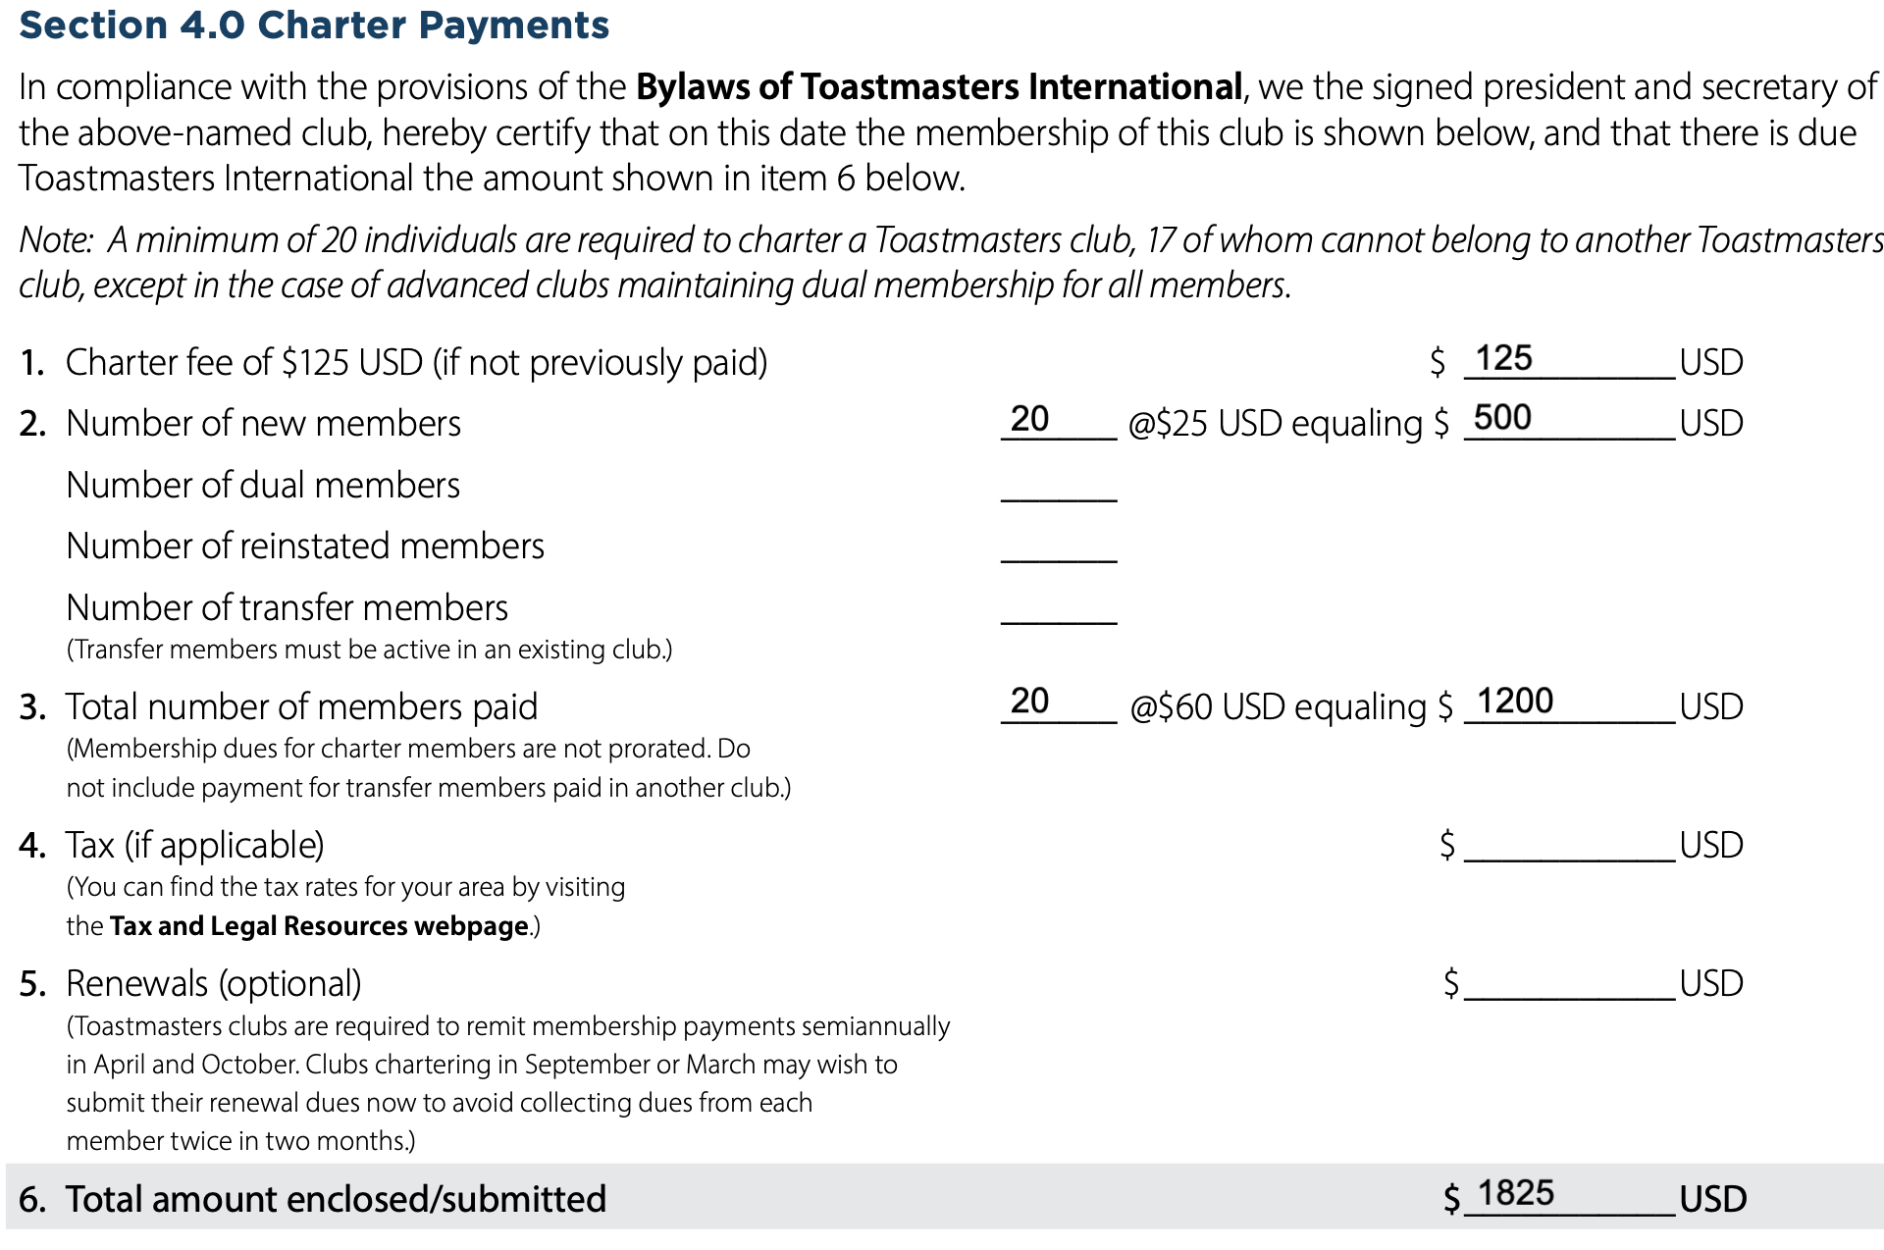

Form 2: “Club Charter Requirements Form”
$1,825
BASE CHARTER COST (USD)

Slide 16
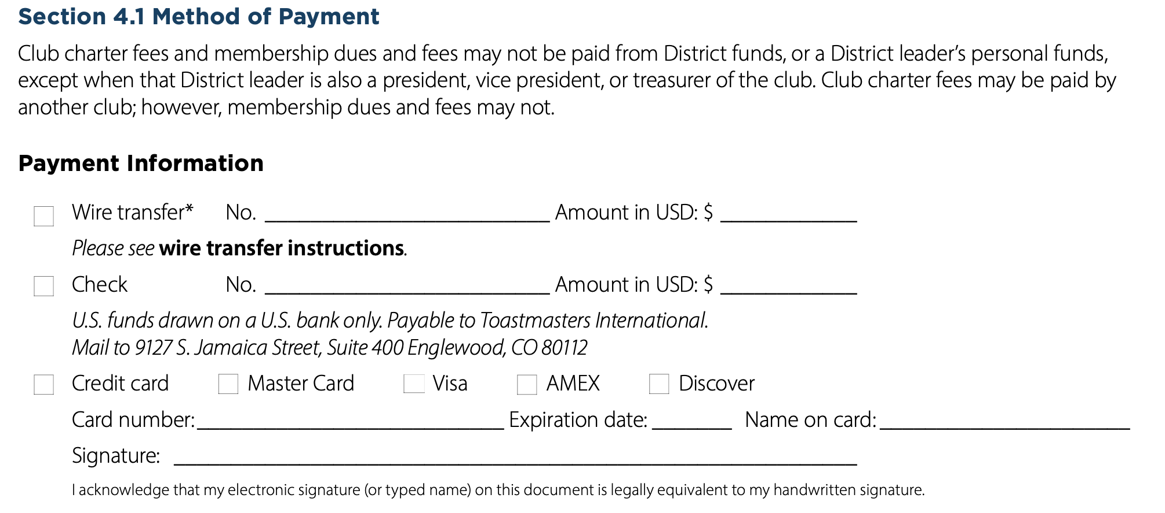
Form 2: “Club Charter Requirements Form”
    - You can SKIP this as this is confidential information and there might be other members in CC when you send charter papers. If you want to add then make sure not to keep anyone in CC.
- 2nd option is to call them and give the payment details on call.

Slide 17
Part 3: Excel Member Roster
Formulating formatting rules and data mapping configurations for the template: "433-charter-membership-and-club-officer-information_2.xlsx".

Slide 18
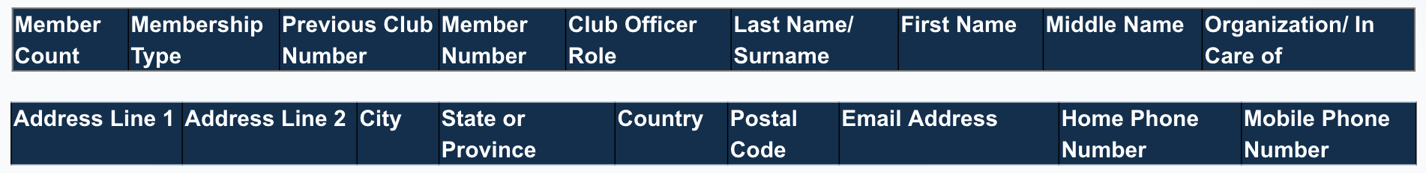
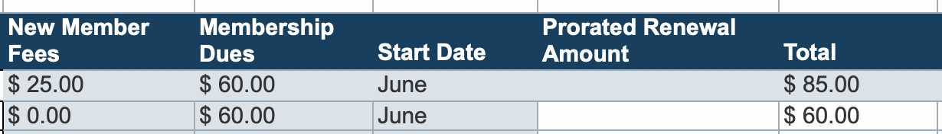
Roster Audit Rules
Roster Capacity Constraints: The blank roster "433-charter-membership-and-club-officer-information_2.xlsx" must contain at least 20 unique individual names and details to pass validation
Below are the details you need to fill OR ask the management to fill the excel sheet and you verify:
    This is automated sheet you need to select 25$ and 60$ from the dropdown and it will calculate in Total by itself.
Select month from the dropdown of StartDate. Can leave “Prorated Renewal Amount” as blank.

Slide 19
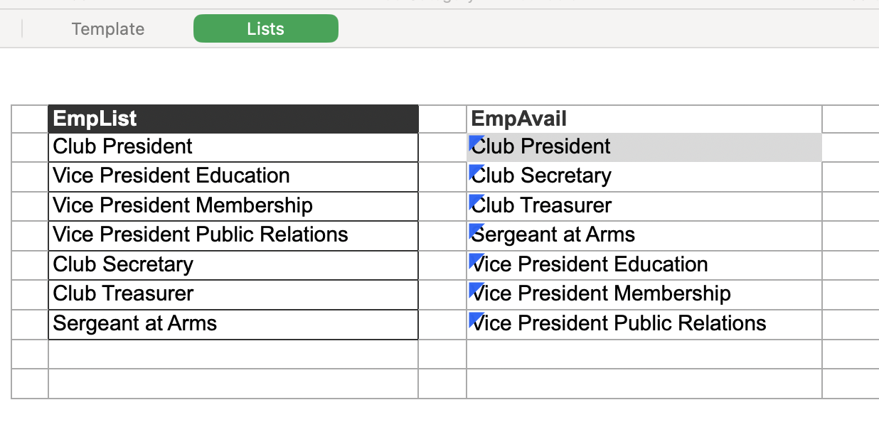
Roster Audit Rules
Officer Matching: In the subsheet you need to add the Excom roles.

Slide 20
Part 4: Prepare Invoice
Two types of Invoice are there: PERFORMA INVOICE and TAX INVOICE

Slide 21
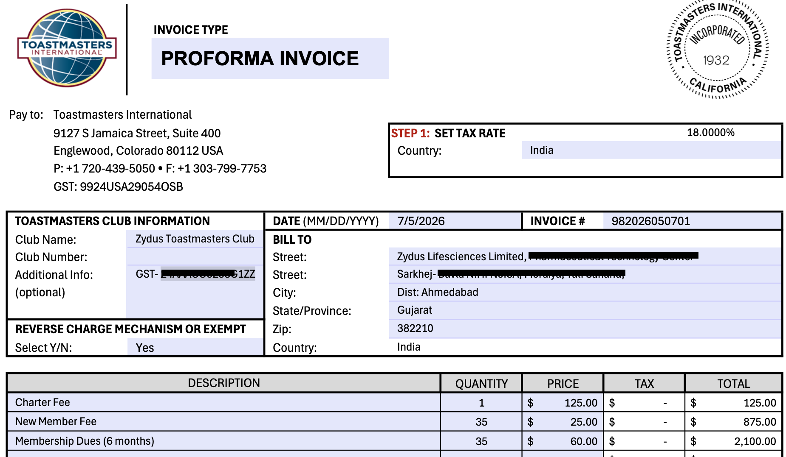
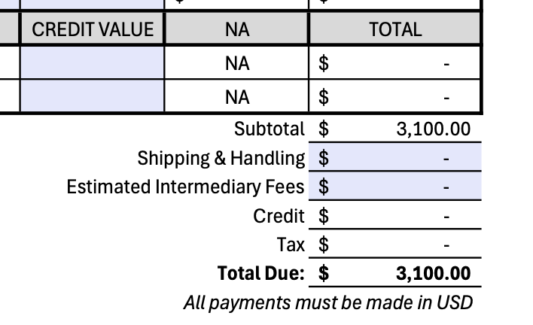
INVOICE: “Club Charter PERFORMA INVOICE”

Slide 22
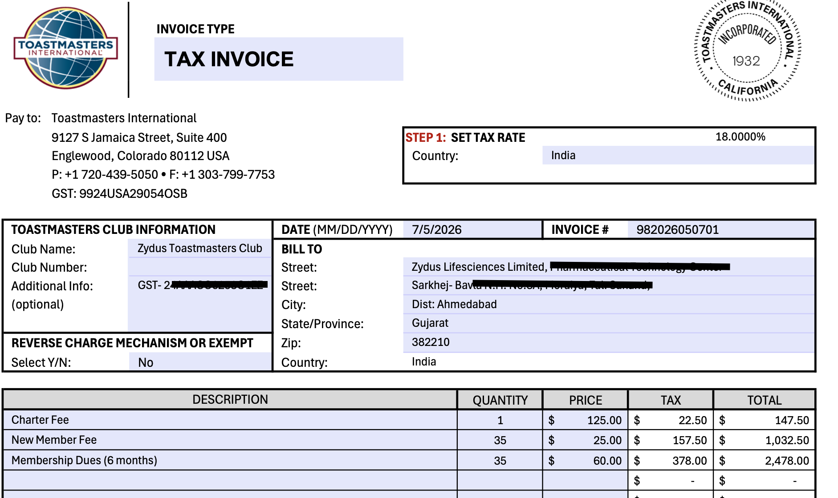
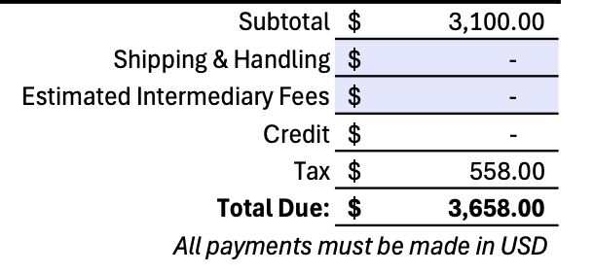
INVOICE: “Club Charter TAX INVOICE”
    Make sure to ADD BANK BACKEND / TRANSFER chargers OR else you will have to ask the team to make the payment again.
    Preferred to keep 20$ as Bank/Transfer fees.

Slide 23
Ready for Submission?
Perform a final audit with CGD team, TRIO and Division Director on the document files before packaging and emailing them to Toastmasters World Headquarters!

Slide 24
Part 5: Charter your new club - Activity

Slide 25
THE CASE
A New Club Takes Shape in Alwar
C
CLUB TYPE
M
MEMBER MIX
T
MEETING DETAILS
Fresh, independent, community-run club — not affiliated with any company.
20 members total: 13 New, 3 Dual members, 2 reinstated and 2 transfer members.
Sundays, 11 AM–1 PM, in-person at Alwar Community Hall, Sector 10, Alwar.
E
EXECUTIVE COMMITTEE
S
SPONSOR CLUBS
TM
MENTOR & SPONSORS
President, 2 VPs, Secretary & Treasurer appointed. VP Education and SAA still unassigned.
Delhi Toastmasters and Jaipur Toastmasters are sponsoring this new club.
TM Asankhya has agreed to mentor the new club through chartering
DTM Shwetank and TM Kashish are supporting with pre-charrter formalities as sponsors
1

Slide 26
THE ACTIVITY
Task To Do
1
2
Fill the Forms
Calculate the Payment
Complete every required field across the Application to Organize, Charter Requirements Form, and Excel Roster for this club.
What is the total payment for chartering this club, considering dues for 6 months?
3
4
Spot the Gaps
Can It Charter?
Is there any information missing before this club can be chartered? What exactly is it?
Can the club be chartered without the 2 EC members — VP Education and SAA — in place?
2

Slide 27
Thank You!

